Slide 1
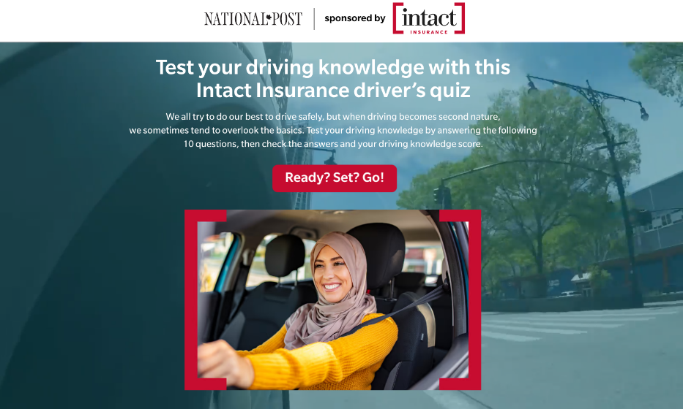
Intact Insurance
CASE STUDY
Intact Insurance is a leading provider of auto and home insurance in Quebec. Their ‘my Drive’ app helps their customers collect information on their driving habits and provides a personalized insurance premium. Users can also become more informed on their driving and how to improve it—lowering their insurance premiums as well.
STRATEGY
RESULTS
The goal was to position Intact Insurance as an authority in the auto insurance space and provide a glimpse into what their app can do for users.
To achieve this, an interactive dynamic page was created. This stand-alone interactive page was amplified both on and off network to a targeted audience. The format was an interactive quiz, and the questions tested a user’s general knowledge on driving, road rules, and driving habits.
Based on their answers to the questions (out of 10), the user arrived at an end results page that gave them their score and more information about the importance of improving driving habits. Intact Insurance’s ‘my Drive’ app was linked for more information.
Link to quiz: https://view.ceros.com/postmedia-network/23-78-intact-insurance-ceros-page-feb14-final-1/p/1
Postmedia's strategy resulted in an incredible number of impressions and engagement. Through social amplification, thousands of users completed all 10 questions of the quiz, and many even saved the quiz for later. An engagement rate of 4.16% (compared to a benchmark of 0.8%) demonstrates how the interactive quiz piqued many readers’ interests and how interactive content is an effective way to increase brand awareness.
5x
800K+
2min+
300K+
INCREASE IN CTR COMPARED TO BENCHMARK
SOCIAL IMPRESSIONS SERVED
AVERAGE TIME SPENT ON PAGE
TOTAL PAGE VIEWS
5x
8K
450K+
29K+
HIGHER AVERAGE ENGAGEMENT RATE. THAN BENCHMARK
AVERAGE PAGE VIEWS PER DAY
INTERACTION CLICKS
UNIQUE VISITORS TO PAGE

